Slide 1

Spark Tutorial
Learn about the spark theory along with hand on practices of pyspark….

Slide 2
Course Curriculum :
Overview ( Cause of Coming of Spark )
All About Apache Spark - Introduction - Hadoop vs Spark - Spark Features - Full Spark Architecture - Core Component of Apache Spark - Short Spark Architecture - Key Component (Applications ) of Spark Architecture - More Details About The Execution of Cluster Manager And Driver - More Details About RDDs and DAG
Running a Spark Application
Apache Spark Installation on Window and Ubuntu
Spark API - Spark SQL/Dataframe And Demo - Spark SQL/Dataframe And Demo : Using Pyspark - Spark Streaming And Demo - Spark MLlib And Demo
Spark Interview Questions

Slide 3
Overview ( Cause of Coming of Spark) :
We have mostly use smart phones and other devices and there will be wondered that how to generate the data in devices as form of music, emails, phone calls, searches etc approximately 4 gigabyte to 4 exabyte data in every months….
And it is huge amount of data which is call the Big Data.
Let’s have a look data generated per minute on the internet by .. - snapchat ( approx 2.1 million ) - google search ( approx 3.8 million ) - facebook ( approx 1.0 million ) - youtube ( approx 4.8 million ) - emails ( approx 188 million )
How to classify the data so that data will called Big Data. So this is possible with the concept of 5 V’s ….
Volume : In how much amount data generate like ( hospital and clinic generate approx 2000 ExaBytes annually )
Velocity : In which speed data generated like ( Patient records and Test result generated at very high speed )
Variety : In which format data generate like ( structure , non structured or semi - structured format )
Veracity : Accuracy and Trustworthiness generate the veracity
Value : Best data detention, better performance and reduce code are the value of big data.

Slide 4
Now the question is, How do we store and process the big data after getting huge amount of data…
For handle of the big data, there are used some framework which are -
Cassandra
Hadoop
Apache Spark
Let’s take hadoop as an example for big data process…
Hadoop :
Hdfs - Hadoop uses distributed file system known as a Hadoop Distributed File System ( hdfs ) to store the big
data. If files is big then files data are broken down into small chunks ( default 128 MB ) then stored on various machine with some
copies of data different data chunk. So if any case, any machine is failed then data will be safe on another machine.
Yarn - Yet another Resource Negotiator is used for job scheduling and manage the cluster.
MapReduce - It is technique to process the big data. Which split the given task into small task and distributed on different machine And these machine complete the assign task in parallel processing, combine the return results by each of them. So these technique make the process easy and fast.
Analyse Process Data - Now store the process data on databases for the analyse the various applications.
Ex. 1. gaming data use for find the user data to analyse that in which stage user mostly chose the pause, restart and quit option. Create the stories for best user experience.
2. Big data also used in disaster management that predict on landfall in advance for prevention.

Slide 5
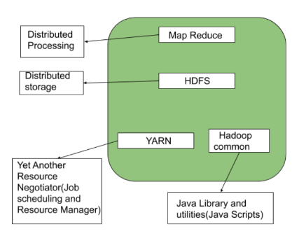
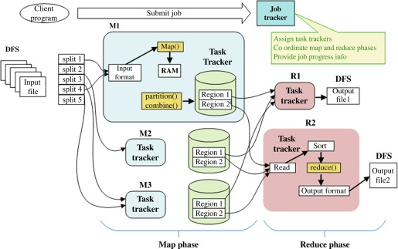
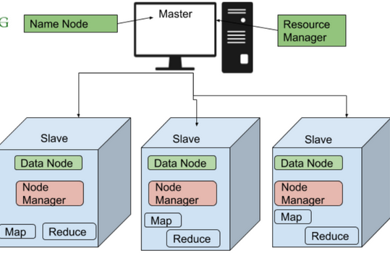
Let’s see the hadoop picture for full process…

Slide 6
All About the Apache Spark :
Introduction : Apache Spark is an open-source data processing engine to store and process data in real-time across
various clusters of computers using simple programming construct.
It is support various programming languages like R, Python, Java And Scala. By default it is written on the Scala.
Developer and data scientists incorporate spark into their application to rapidly query, analyze and transform data at scale.
Hadoop Vs Spark :
Hadoop | Apache Spark
Processing data using MapReduce in hadoop is slow | Spark process data 100 times faster than MapReduce as it is done in-memory
Perform batch processing of data | Perform both batch and real time processing data
Hadoop has more time in execution because it is written in java | Spark has less time in execution because it written in scala
Hadoop support Kerberos authentication which is difficult to manage | Spark support authentication via shared secret. It can also run on YARN leveraging the capability of Kerberos.

Slide 7
Spark Feature :
Fast Processing - Spark contains Resilient Distributed Dataset (RDD) which saves time taken in reading, and writing operations and hance, it runs almost ten to hundred times faster than hadoop.
In-memory computing - In spark, data is stored in the RAM ( basically in cache ), so it can access the data quickly and accelerate the speed of analytics.
Flexible- Spark support multiple languages and allows the developers to write applications in Java, Scala, R or Python.
Fault tolerance - Spark contains RDD) that are designed to handle the failure of any worker node in the cluster. Thus it ensures that the loss of data rescues to zero.

Slide 8
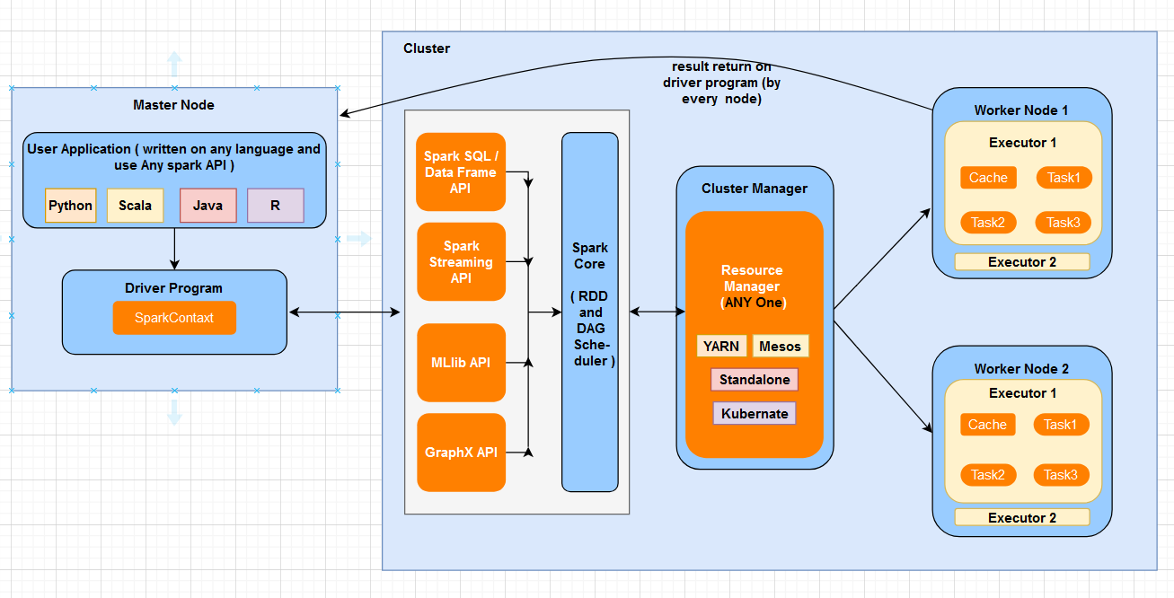
Full Spark Architecture :

Slide 9
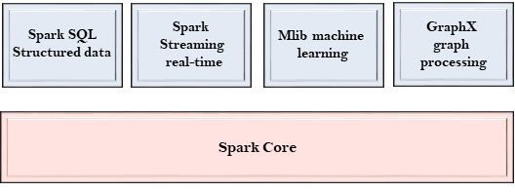
Core Component of Apache Spark :
Spark Core - Spark core is the base engine for large-scale parallel and distribution data processing. Where all the configuration have set that are responsible -
Memory management
Fault recovery
Scheduling distribution and monitoring jobs on a cluster
Interacting with storage systems
Note : spark core don’t have itself storage while it realize as storage and used the other storage that could be
mysql database, aws s3, hadoop file system (hdfs) etc..

Slide 10
RDD - Spark core is embedded with RDDs ( Resilient Distributed Datasets ), an immutable fault-tolerant,
distributed collection of objects that can be operated on in parallel.
Resilient - existing
Distributed - distributed on clusters node
Dataset - data
There are two methods for RDDs :
1. Transformation : There are operations ( such as map, filter, groupby, join, union etc. ) that are
performed on an RDD that yields a new RDD containing the result.
2. Actions : These are operations ( such as reduce first, count, show, display etc. ) that return a
value after running a computation on an RDD.
DAG - DAG is stade for Direct Acyclic Graph and It is useful for create the graph with logical and physical plan
for each and every job/action by the driver program. And these are required when execute the task on
cluster nodes.
NOTE : Further we will cover more about the RDD and DAG ….

Slide 11
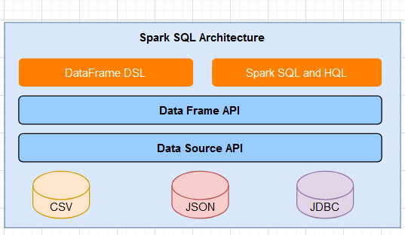
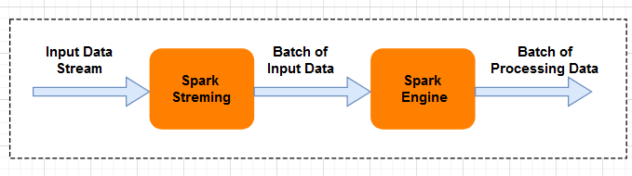
Spark SQL - Spark SQL framework component is used for structured and semi-structured
data processing.
Spark Streaming - Spark Streaming is a lightweight API that allows developers to perform batch processing and real-time streaming of data with ease.
And It provide secure, reliable and fast processing of live data stream.

Slide 12
Spark MLlib - Spark MLlib is a low-level machine learning library that is simple to use, is scalable, and compatible with various programming languages.
MLlib eases the deployment and development of scalable machine learning algorithms.
It contains many machine learning libraries that have used in various machine learning algorithms.
- Clustering
- Classification
- Collaborative Filtering
Spark GraphX - GraphX is Spark’s own graph computation engine and data store.
- Provides a uniform tool for ETL
- Exploratory data analysis
- Interactive graph computations.

Slide 13
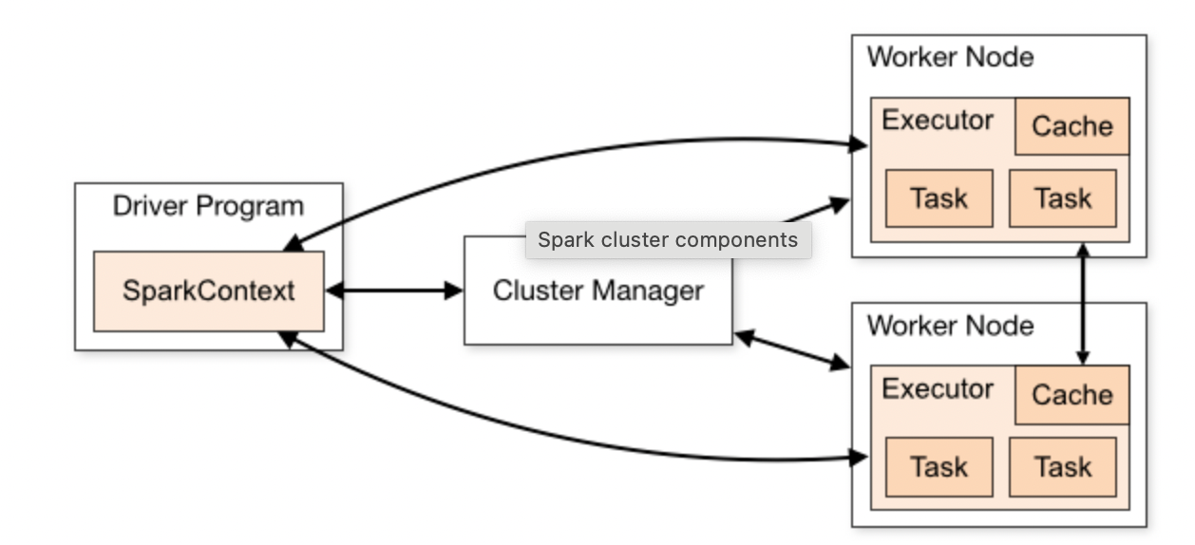
Short Spark Architecture : Apache spark uses a master-slave architecture that consists of driver that runs on the master nodes, multiple
executors which run across the worker nodes in the cluster.

Slide 14
Key Component (Applications) of Spark Architecture :
Driver - Driver is a program on the master node which declare the SparkContext that is the entry point for
connect with cluster and controls the execution of parallel operation on clusters.
It is responsible for -
- Run the user program and convert job into tasks by creating the RDDs and DAG Scheduler through SparkContext.
- Scheduling tasks on executor through the DAG Scheduler
- Coordinating between executors.
- Tracking the progress of tasks and handling failure.
Driver program can execute on different mode ;
1. Cluster Mode 2. Client Mode
NOTE : Further we will know more details about the driver execution mode…….
SparkContext - SparkContext is the gateway to all spark functionalities like use rdd, transformation, actions..
It is responsible for -
- Connecting to the cluster manager/resource manager.
- Acquiring resources on the clusters.
- Creating RDDs and Performing transformation and action on them.

Slide 15
Cluster Manager - Cluster manager is responsible to allocate the resource across the cluster. And spark support various cluster managers.
- Local
- Standalone Cluster Manager
- Apache Mesos
- Hadoop YARN
- Kubernete
NOTE : Further we will know more details about cluster managers/resource managers execution.….
Worker Node - Executors are work as worker node that are used for run the multiple individual tasks. And each application can contain own executor that ;
- Execute code assigned to them by the driver.
- Report the status of computation and storages to the driver.
- it can stores the data for RDDs for better performance that will happened by using cache or persist in user
Program. Like SparkContext.cache( ) or SparkContext.persist( )
Tasks - Tasks are the smallest unit of work in Spark. They are a part of a job, which is divided into one or more stages. Each stage is further divided into one or more tasks that run on individual executors. Tasks are assigned
to executors based on data locality and resource availability.

Slide 16
More Details About The Execution of Cluster Managers And Driver :
For Execution of Cluster manager and Driver, We are required to set the configuration in spark which
is used at spark-submit the program. So the configuration will be following -
- - Master : Like local, standalone cluster, mesos, yark etc. ( Used to set any the cluster manager for run the
spark cluster )
- - Deploy Mode : Like Client or Cluster mode ( Used to set mode type to run the driver. )
Example :
There are various cluster manager which we can set as cluster master ;
1. Local : Run spark cluster on local machine where no of worker node run as thread ( set this to the number of cores).
ex ;
- - master : local ( run with single worker thread )
- - master : local[K] ( run with K worker thread )
- - cluster master : local[K, F] ( run with K worker thread and F maxFailures )
- - cluster master : local[*] ( run with many worker threads as logical cores)
- - cluster master : local[*, F] ( run with many worker threads as logical cores and F maxFailures )

Slide 17
2. Standalone Cluster : Simple cluster manager which is able to connect standalone cluster master node with
worker node machine ( which will be another machine ). In this cluster default port are 7077.
In case of Standalone, Cluster Manager work as cluster master node/driver node/client
where driver program ( manage SparkContext ) or
user program ( contains read/write operation, transformation
and actions. ) are available.
ex ;
- - master : spark://HOST:PORT
3. Hadoop YARN : Simple hadoop cluster manager which is able to connect YARN cluster with client machine.
In case of YARN, Cluster Manager work as Resource Manager on hadoop yarn master node
This master node connected to client machine ( our itself machine ).
Where driver program or user program are available on client.
ex ;
- - master : yarn

Slide 18
4. Apache Mesos : General cluster manager which is able to connect with mesos cluster node with client machine.
In this cluster, default port are 5050.
In case of Mesos, Cluster Manager work as resource manager on hadoop mesos master
node with mapreduce and other application. Master node connect to client
machine where driver program or user program are available.
ex ;
- - master : mesos://HOST:PORT ( run with single worker thread )
5. Kubernete : Kubernete is also user as cluster manager for setup the master - slave cluster.
ex ;
Please Use This Link For Reference -
REFERENCE LINK : https://spark.apache.org/docs/latest/submitting-applications.html

Slide 19
Driver is a program on the master node/client machine which can deploy/execute on different mode.
1. Client Mode : In all the spark cluster manager cases, Spark Driver remains on the Client machine that submits
the Spark application in client mode. And all the executors run in the Spark cluster
worker node. So the downside of this is that there can latency issues here.
ex;
- - deploy mode : client
2. Cluster Mode : In standalone cluster manager cases, Spark Driver runs on one of the worker nodes within
the Spark cluster and In yarn/mesos cluster manager cases, Spark driver run on the
yarn/mesos application master node where client machine submit the spark application
in cluster mode.
ex;
- - deploy mode : cluster

Slide 20
More Details About RDDs And DAG :
RDD - Spark core is embedded with RDDs ( Resilient Distributed Datasets ), an immutable fault-tolerant, distributed
collection of objects that can be operated on in parallel.
There are two type of apache spark RDD operations ;
1. Transformation : A Transformation is a function that create a new RDD from the existing RDD means It takes
RDD as input and produces one or more RDD as output. Each time it creates new RDD when
we apply any transformation. Thus, the so input RDDs, cannot be changed since RDD are immutable in nature.
And these Transformation will apply ( on executor ) to generate RDD as the actual dataset for use, when action is
perform on executors in worker node. It’s divided into two type ;
- Narrow Dependency Transformation : Transformation that doesn’t require any data movement between
partitions on different executors. like - filter, map, select, union etc operations..
Ex. - test_df = flight_data.filter("DEST_COUNTRY_NAME=='United States'")
- Wide Dependency Transformation : Transformation that does require data movement between partitions
on different executors. like - groupBy, joins etc operations..
Ex. - total_flight = test_df.groupBy("DEST_COUNTRY_NAME").agg(sum("count"))

Slide 21
2. Action : We want to work with actual dataset, at that point action is performed. And when action will triggered
then new RDDs is not formed or created.
Thus, Action are Spark RDD operations that give non-RDD values. The values of action are stored to drivers or to the
external storage system.
An action is one of the ways of sending data from Executor to the driver. Executors are agents that are responsible
for executing a task. While the driver is a JVM process that coordinates workers and execution of the task. Some of
the actions of Spark are: count, collect, top, aggregate, foreach etc..
Ex. - total_flight.show()
REFERENCE LINK : https://data-flair.training/blogs/spark-rdd-operations-transformations-actions/
DAG - A DAG is Directed Acyclic Graph, a type of graph whose node are directionally related to each other and don’t form
directional closed loop.
They offer a great way to applying transformation built an RDD lineage, with the entire parent RDDs of final RDD.
RDD lineage, also known as RDD operator graph or RDD dependency graph or Directed Acyclic Graph (DAG) which
is the combination of logical and physical execution plan.

Slide 22
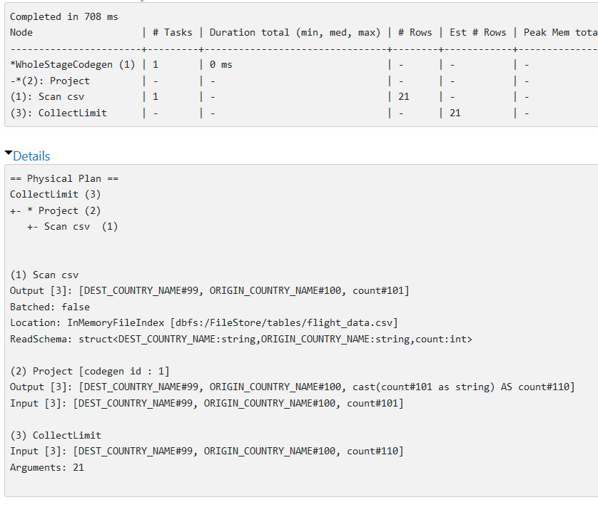
Ex. - A DAG ( Direct Acyclic Graph ) - Physical Plan, Logical Plan or DAG for Small Code.
Code - Physical Plan -
# use to read the data where read and
#inferschema and show all are action.
flight_data = spark.read.format('csv')\
.option('header', 'true')\
.option('inferSchema', 'true')\
.load('/FileStore/tables/flight_data.csv')
flight_data.show()

Slide 23
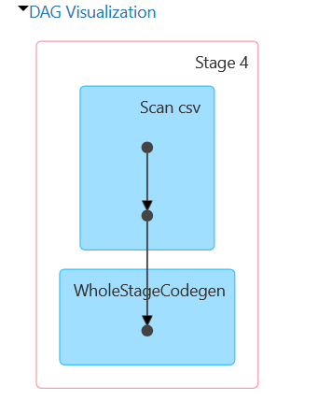
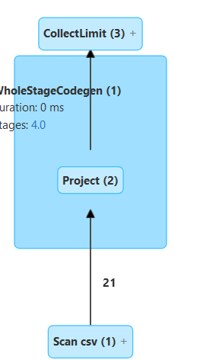
DAG - DAG (SQL/DataFrame Logical Plan ) -

Slide 24
More Details About RDDs And DAG :
RDD - S

Slide 25
Running a Spark Application :
Step-1 : First spark application code will written by developer in different languages like python, R, java or scala that have
sparkContext ( entry point for connect with cluster ), read/write operation, transformation or actions.
Step-2 : Second when spark application submit then entire spark application code will convert into driver program ( that
nothing but it’s JVM pragam ) to run on the spark. Because spark written on scala and supported java code
wrapper.
Note : here driver program can run on master node ( in client mode ) or worker node ( in cluster mode ) .
Step-3 : Third driver program ( JVM ) internally handle the sparkContext for set up cluster manager / resource manager
( in form of YARN, Mesos, Standalone Cluster, Kubernete or local ) and represent the connection with spark cluster.
Where resource manager / cluster manager works as allocate the memory on cluster node / worker node to run
the tasks of jobs of driver program that driver converted from spark application code (written on different
languages using of Spark API ).

Slide 26
Step-4 : Fourth when driver program ( JVM ) run on master node / worker node then this is a high-level code which is
converted into low-level code, called RDDs as Spark core.
Where low-level code will run and sparkContext ( use as low-level code ) is used to create RDDs on
source data or sub RDDs on existing RDDs as well as create RDDs lineage called DAG ( step-by-step physical
and logical plan in form of graph ) by apply transformations ( lazy evaluated means run at time of perform the
action ) and perform actions ( each action work as job ) on worker node / executor node.
Here each low-level code of driver program ( combination of transformation and action ) can have multiple jobs
( like actions which use to apply transformations ), and each job can have multiple stages, and each stages can
have multiple tasks… which distributed on worker node for execution.
Step-5 : Fifth After running all the tasks for all the jobs of driver program ( in form of low-level code ), Result are return
to driver program which is responsible to show the result on local for use.
Note : Same Above Process Use For Every Specific Spark Application.

Slide 27
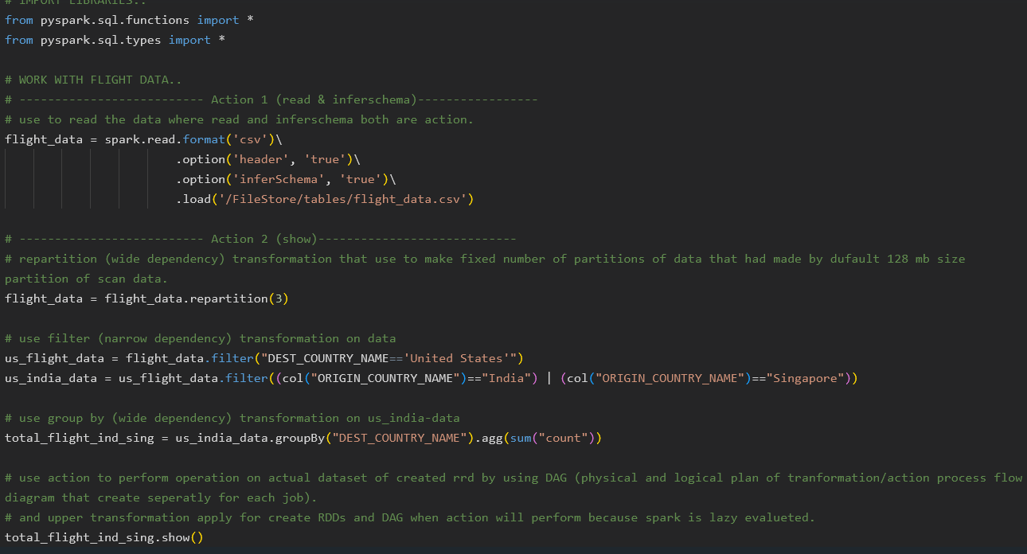
Now we will run the small code as an example for generate the RDD and DAG with Lazy Evaluation ;
1. Code : A small piece of code is called Spark Application ;

Slide 28
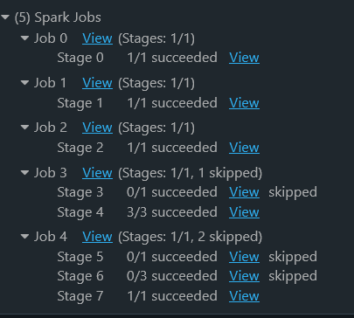
2. Job : Here create the Jobs for each action hit inside the Ex;
above code, where each job can split into multiple
stages and stages split into multiple tasks.
As per our above spark code/application,
- first convert into driver code
- then driver (JVM) code convert into low-level code.
- where sparkContext connect with cluster ( cluster manager
and worker node)
- as a first job, read action will perform and scan the flight
data from source then create initial RDDs using
transformations. But these transformation is not apply
until read action is not perform on worker node.
Because transformation are lazy evaluated and these are
applied with some modification by spark.
- similarly as second job, inferSchema will perform for find
the schema of data.
- similarly as third job, show will perform to display final data after apply all filter
and group by transformations.
Note : With parallel of each job creation and execution, DAG ( Direct Acyclic Graph ) will create
with one and more stages, that will show the full execution process as graph.

Slide 29
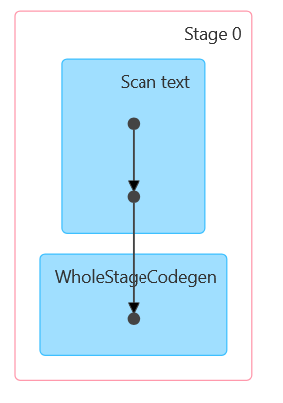
3. DAG : First running spark application process will generate logical plan or Direct Acyclic Graph. Based on analysis
of logical plan, optimize the logical plan and generate the final physical plan for execution.
Stage 0 of Job 1 -

Slide 30
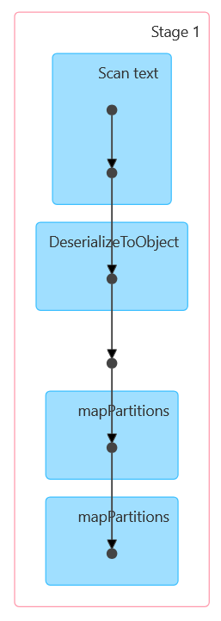
Stage 1 of Job 2 -

Slide 31
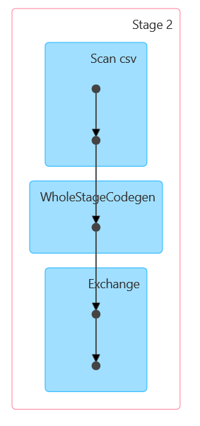
Stage 2 of Job 2 -

Slide 32
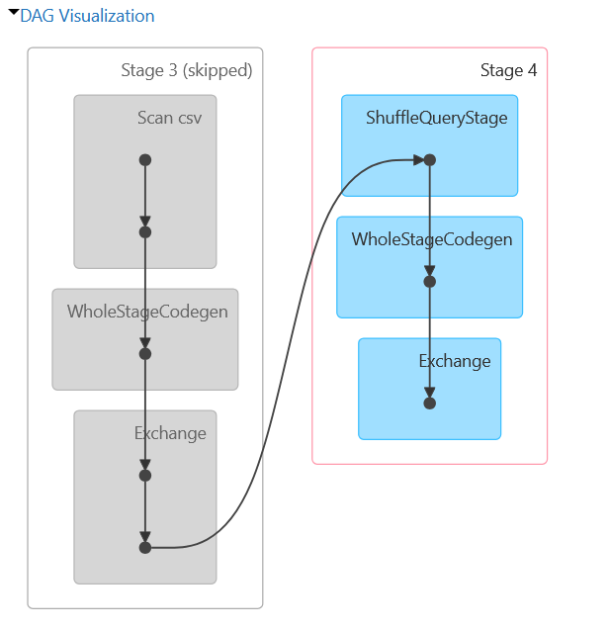
Stage 4 of Job 2 -

Slide 33
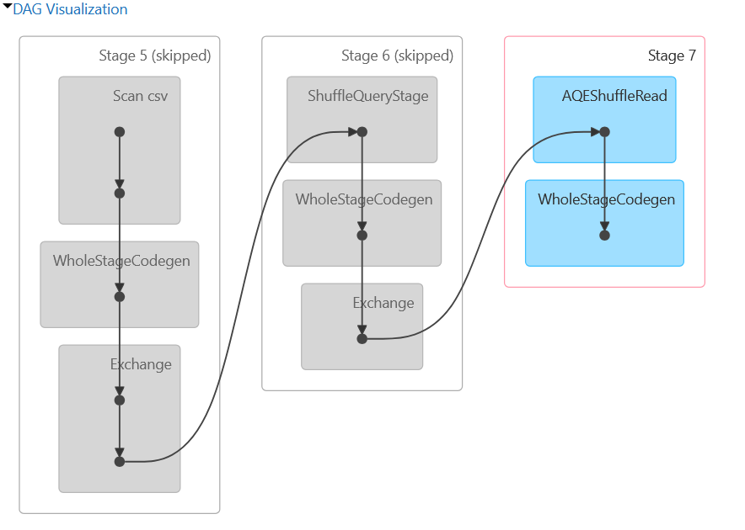
Stage 7 of Job 2 -

Slide 34
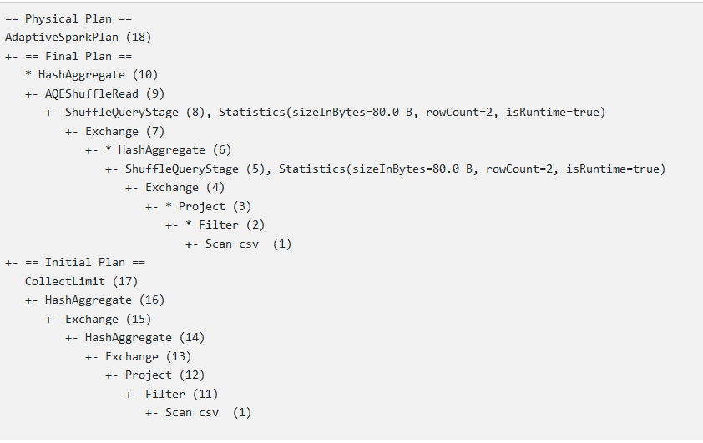
Physical Plan - Show the physical plan.

Slide 35
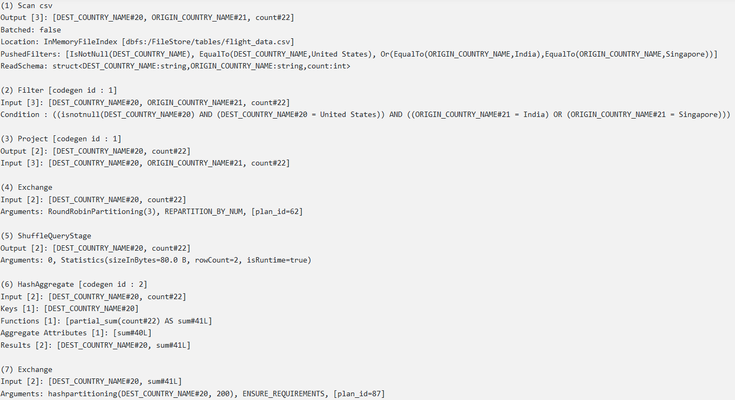
Details Plan - ( Step 1 to 7 )

Slide 36
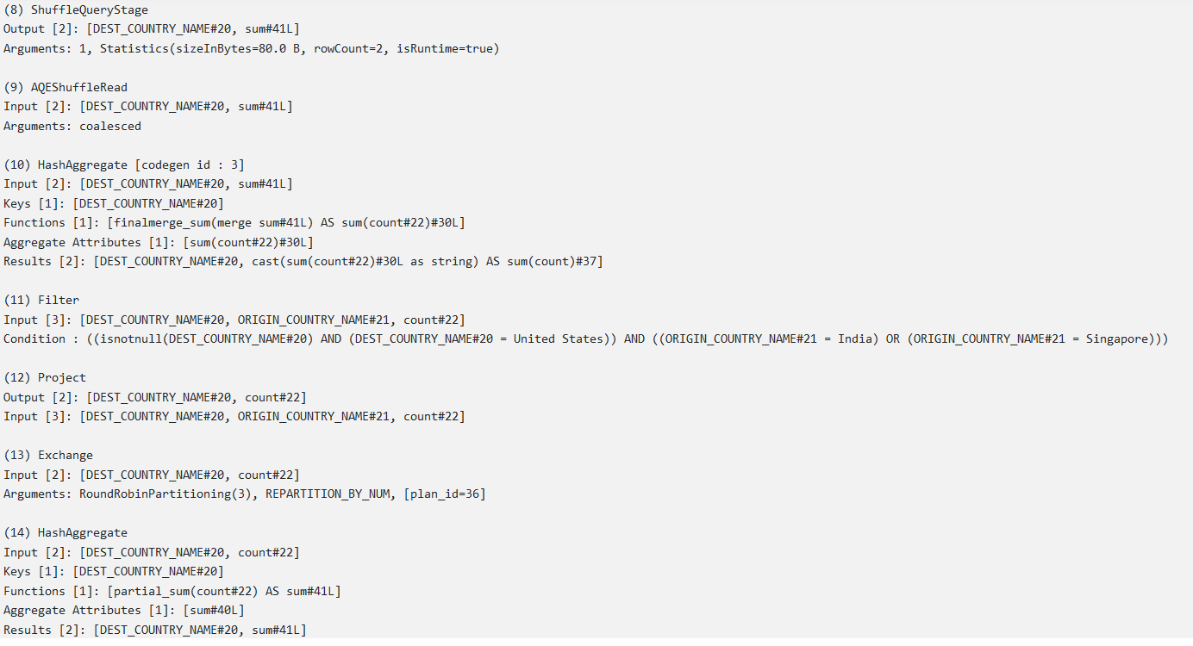
Details Plan - ( Step 8 to 14 )

Slide 37
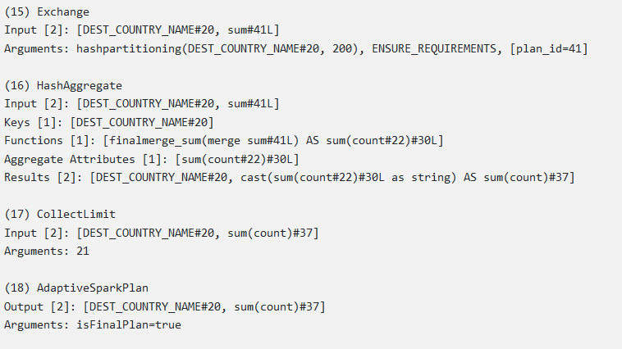
Details Plan - ( Step 15 to 18 )

Slide 38
Apache Spark Installation :
Spark is

Slide 39
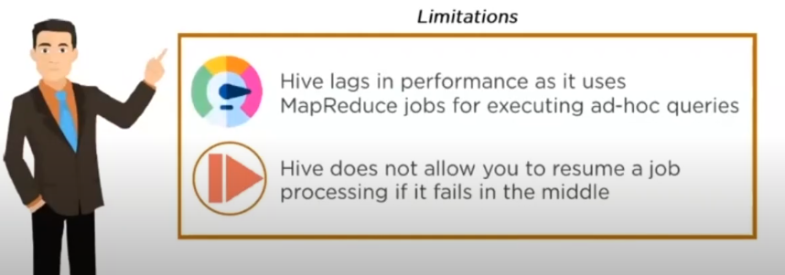
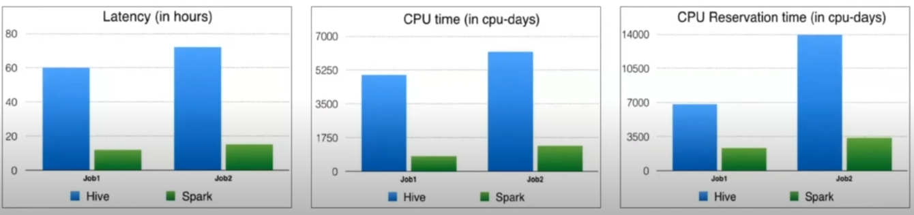
Spark API’s :
Spark SQL/Dataframe And Demo :
What Is Spark SQL/DataFrame : Spark SQL is apache spark module for working with structured and
semi-structured data.
It is originated to overcome
the limitations of Apache
Hive -
Spark perform better
than hive in most
scenarios -

Slide 40
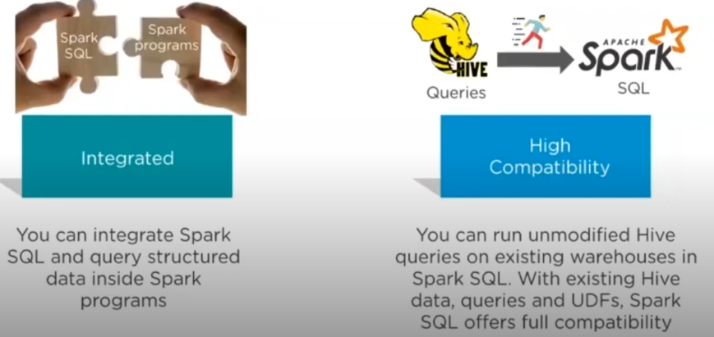
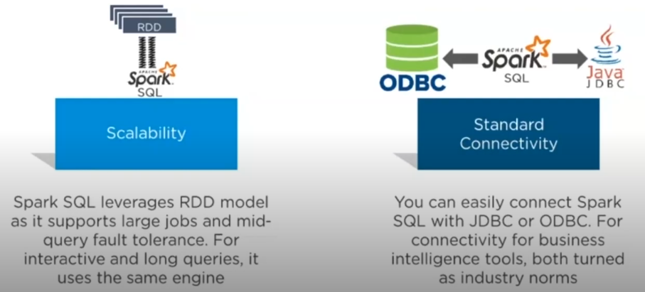
Spark SQL/DataFrame Features : Below are some essential feature of spark SQL that make it a compelling
Framework for data processing and analyzing.

Slide 41
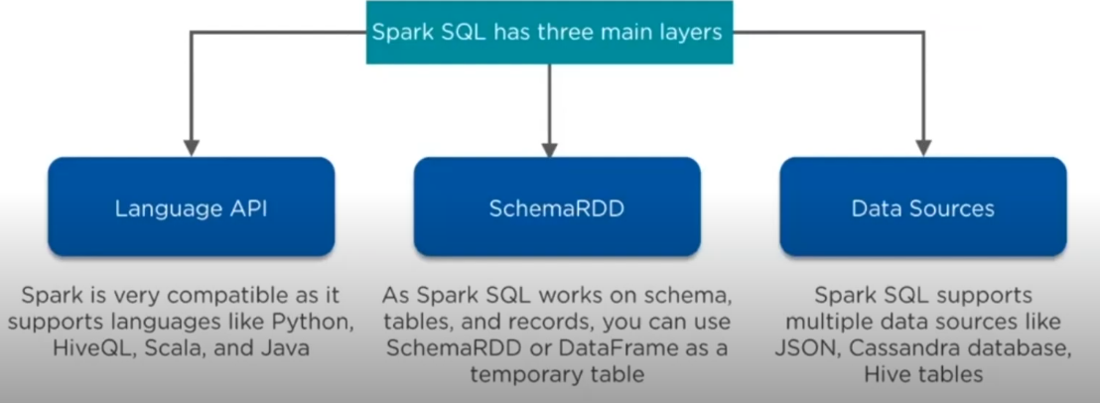
Spark SQL/DataFrame Architecture : Spark SQL is Apache spark module for working with structure data.

Slide 42
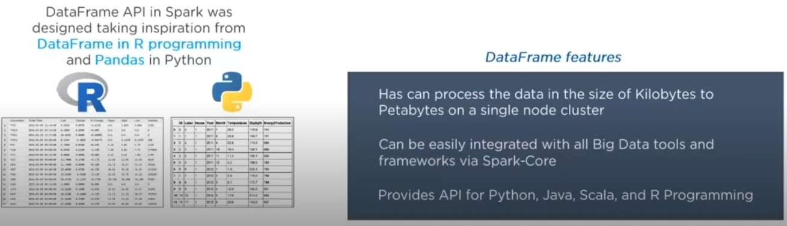
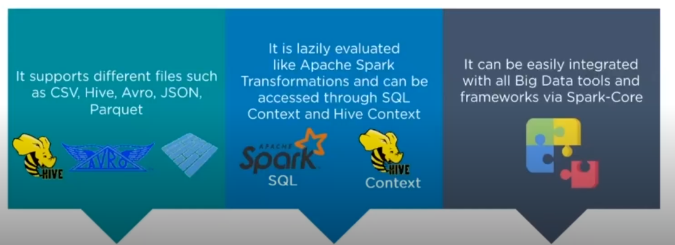
Spark SQL - DataFrame API : A data frame is the domain-specific language (DSL) for working with structured
and semi-structured data i.e dataset with schema.
It support variety of data source through data frame interface.

Slide 43
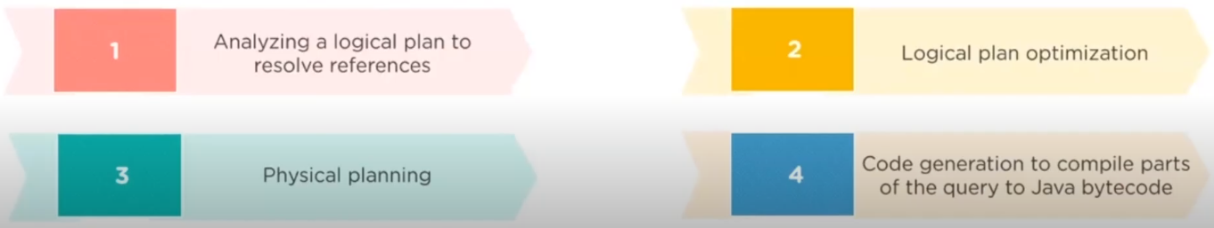
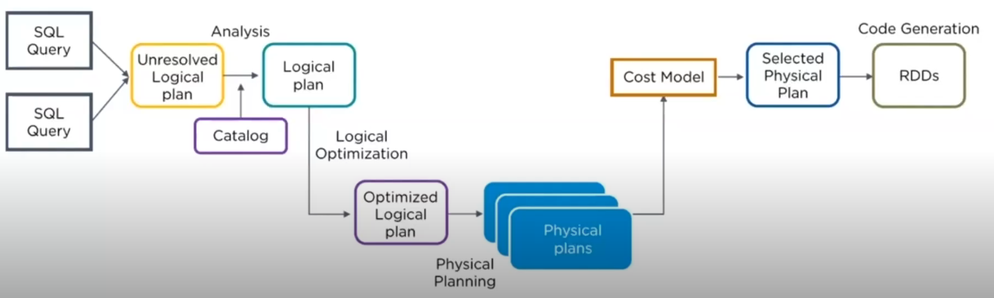
Spark SQL - Catalyst Optimizer : Catalyst Optimizer leverages advanced programming language feature ( such as
scala pattern matching and quasi quotes ) in a novel way to build an extensible
query optimizer.
It work in 4 phases ;

Slide 44
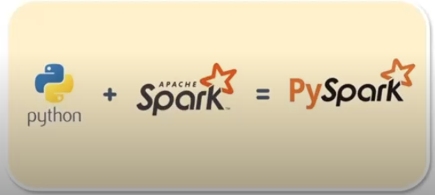
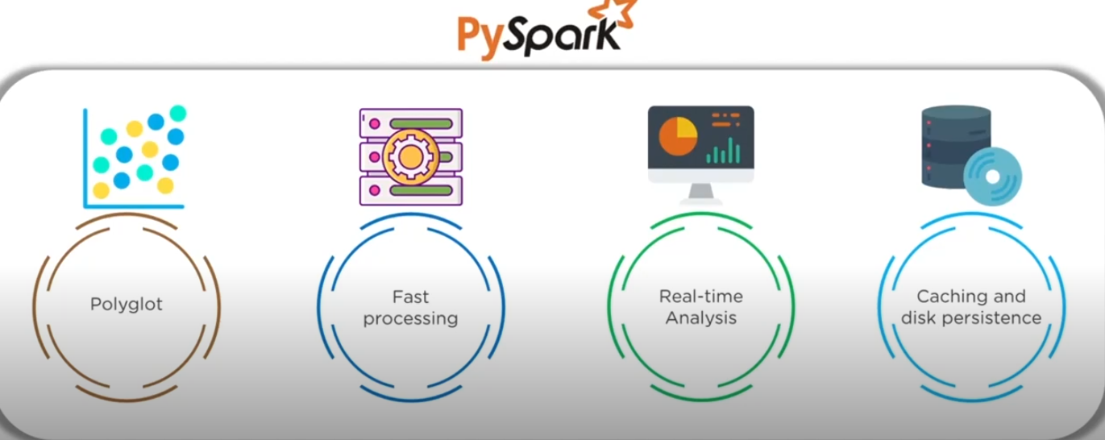
PySpark :
What Is PySpark : PySpark is the python API to support Apache Spark.
PySpark Feature :

Slide 45
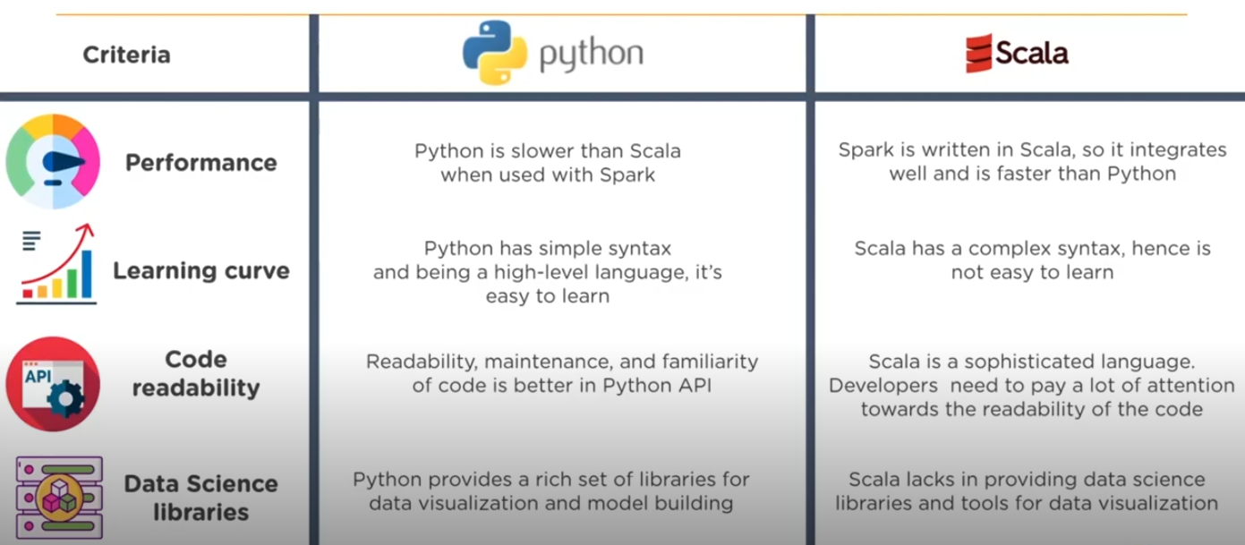
PySpark Feature :

Slide 46
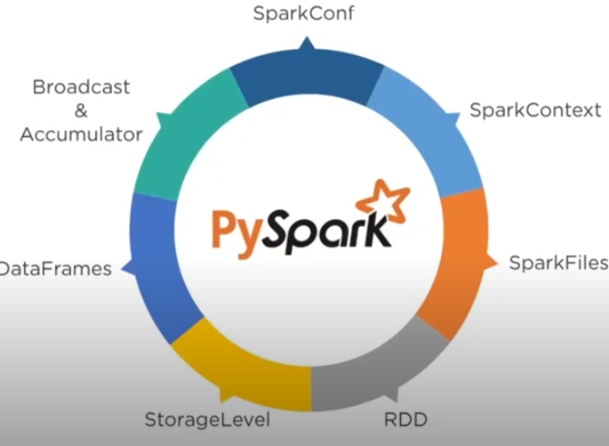
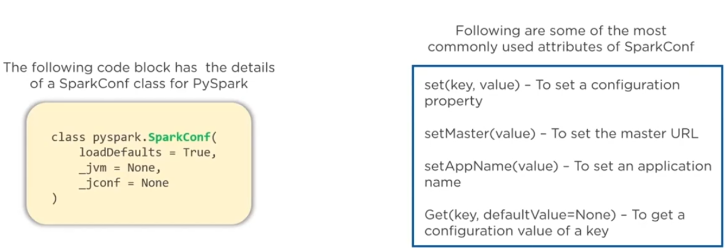
PySpark Contents :
1. SparkConf : SparkConf provides configuration to run a spark application.

Slide 47
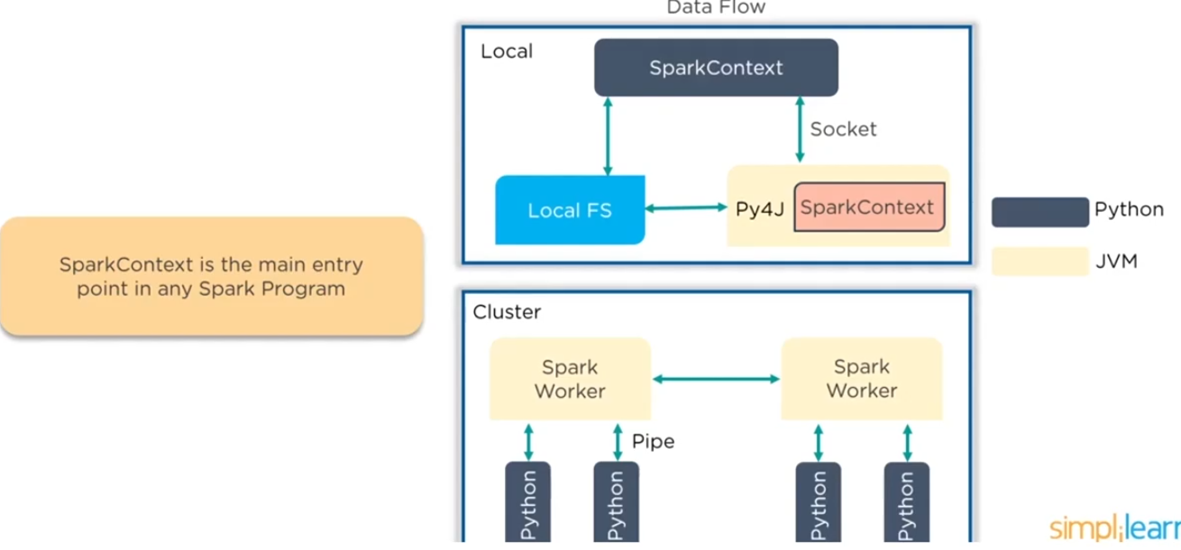
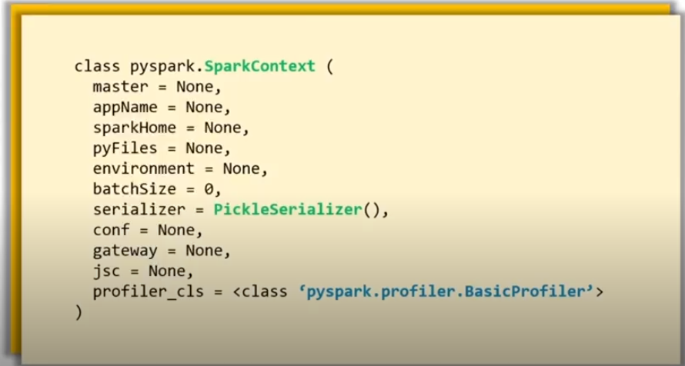
2. SparkContext :
Below code has the details of pyspark class as well as the parameters which spark context can take -

Slide 48
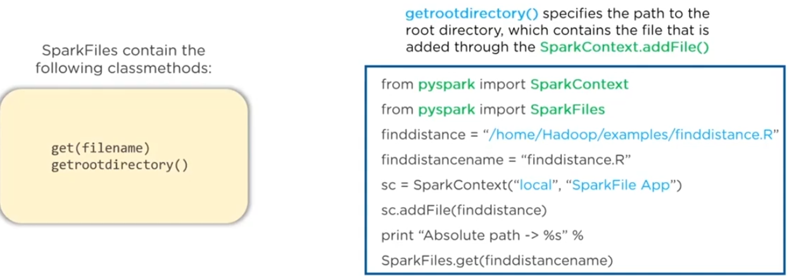
3. SparkFiles : SparkFiles allows you to upload your files using the sc.addFile and get the path on a worker
using SparkFiles.get -

Slide 49
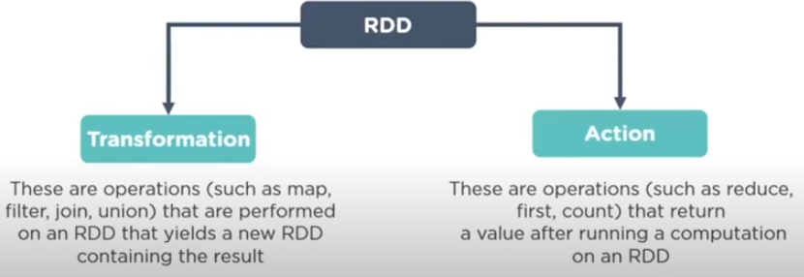
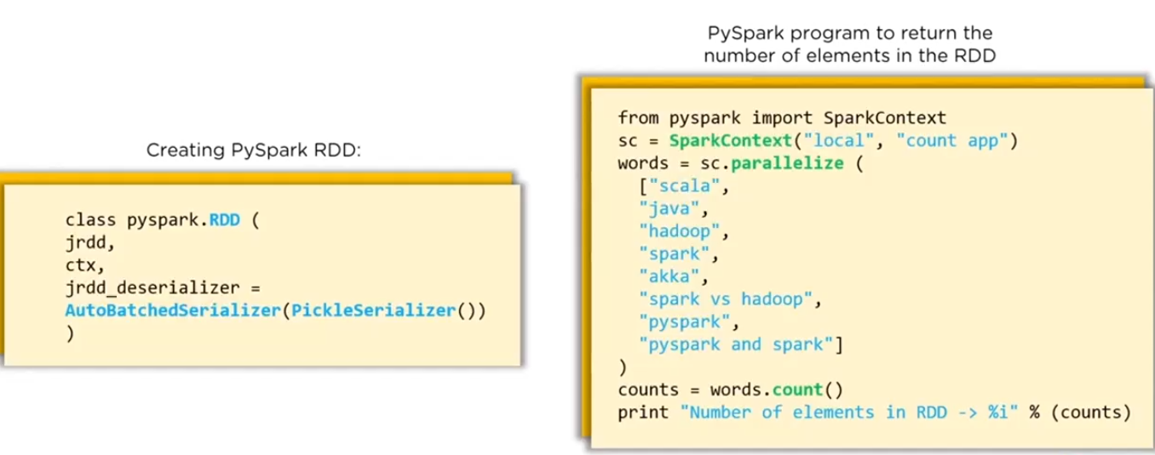
4. PySpark RDD : PySpark RDD ( Resilient Distributed Dataset ) is the basic abstraction in spark. It present
An immutable, Partitioned collection of elements that can be operate on in parallel -
Ex:-

Slide 50
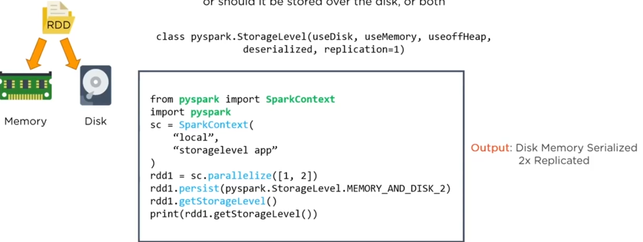
5. PySpark-StorageLevel : StorageLevel decides whether RDD should be stored in the memory or Should it be
stored over the disk, or both -

Slide 51
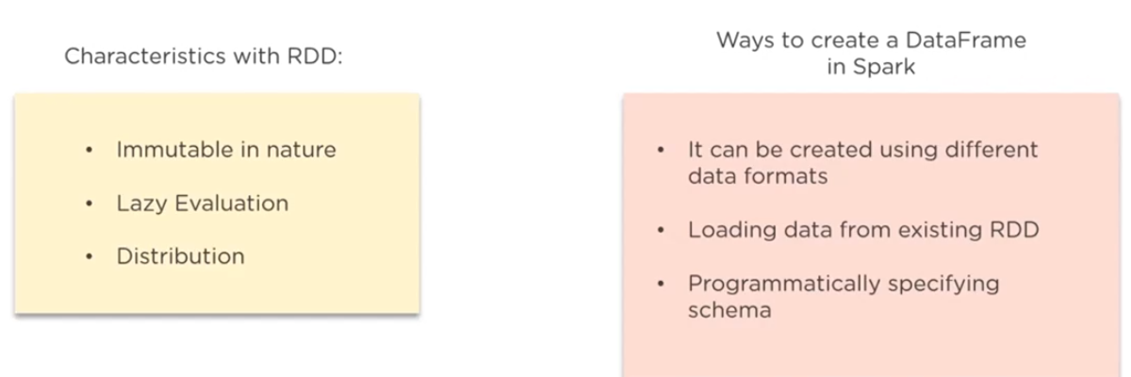
6. PySpark-DataFrames : DataFrames in pyspark is the distributed collection rows with named columns -

Slide 52
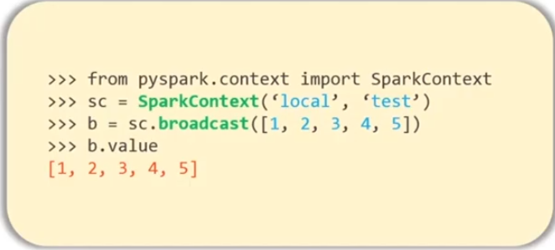
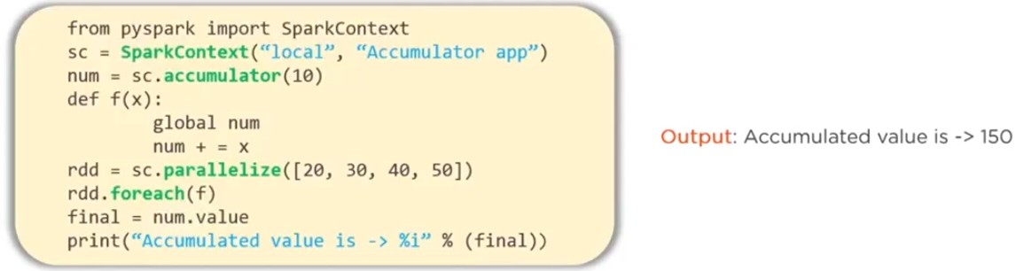
7. PySpark - Broadcast : A Broadcast variable allow the programmers to keep a read-only variable cached on
each machine rather than shipping a copy of it with tasks -
A broadcast variable is created
with SparkContext.broadcast( )
Accumulator : Accumulator are variables that are only added through an associative and
commutative operation -
class pyspark.Accumulator( aid, value, accum_param )

Slide 53
Spark SQL/DataFrame Demo : There is given the demo link of the spark sql / dataframe through databricks.

Slide 54
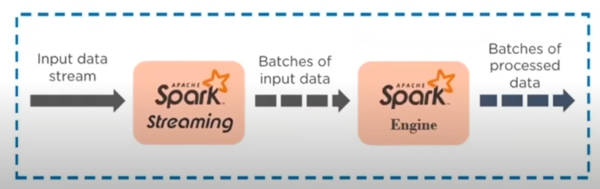
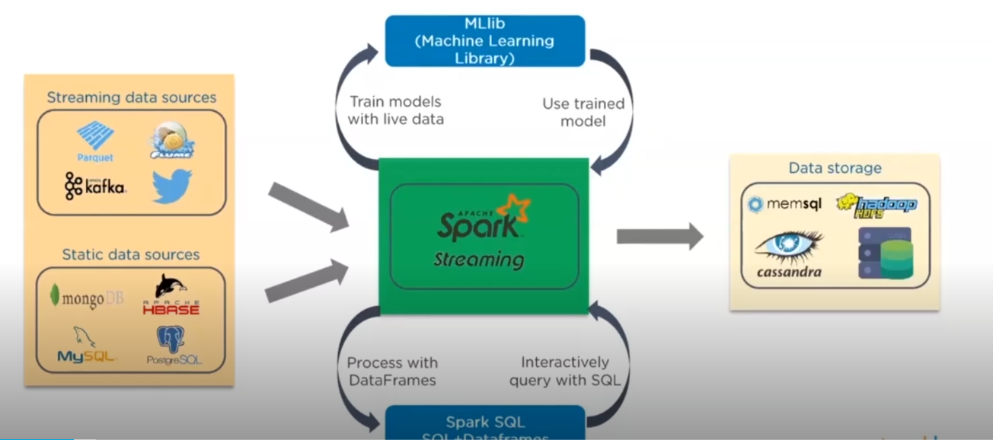
Spark Streaming And Demo :
What Is Spark Streaming : Spark Streaming is an extension of the Spark API that enable scalable, high-throughput, fault-tolerant stream processing of live data stream.
Spark Streaming Data Sources :
There are different sources for data.

Slide 55
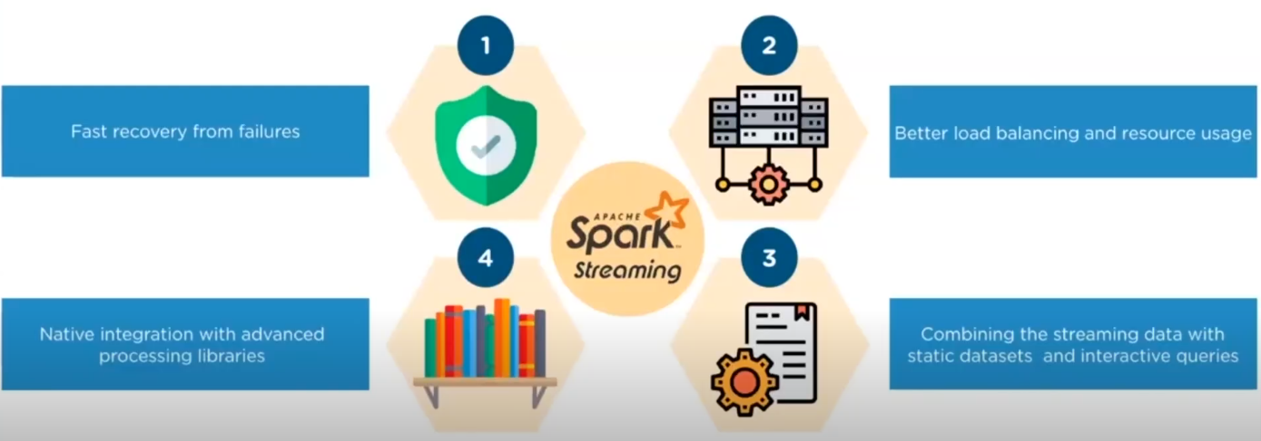
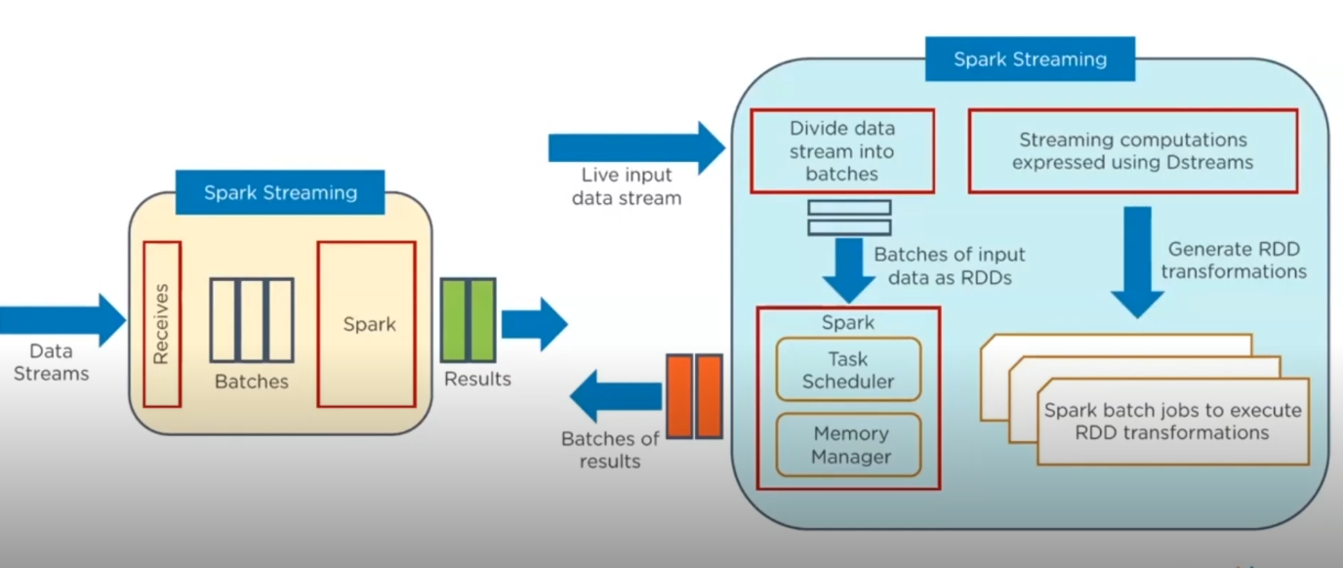
Feature of Spark Streaming :
Four type of feature.
Working of Spark Streaming :
There are flow of working
Spark streaming.

Slide 56
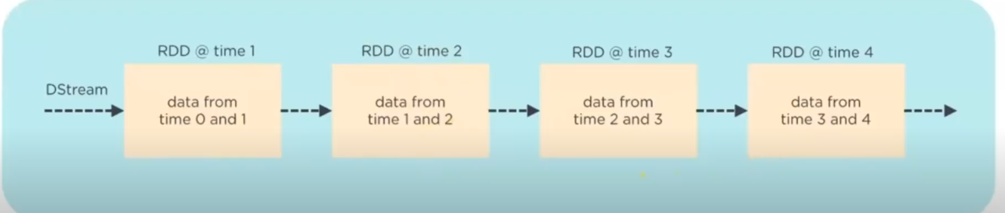

Types of Spark Streaming : There are two or more types -
1. Discretized Streams ( DStreams ) : Discretized is the basic abstraction provided by spark streaming. It represents a continuous stream of data, either the input data stream receive from the source or the process
data stream generated by transforming the input stream.
2. Windowed Stream Processing : Spark Streaming allows you to apply transformation over a sliding window
of data. This operation is called as windowed computation.

Slide 57

Caching / Persistence : RDD are created when perform the transformation and these transformation/RDD can be cached. So that improve the performance of applications and use of RDD will be cache for reutilization in further processing.
1. DStream allow developer to persist the stream data in memory.
2. With the help of persist( ) method. DStream will automatically persist every RDD of that DStream In memory.
3. The default persistence level is set to replicate the data into two nodes for fault-tolerance, input streams thet
Receive data over the networks ( such as kafka, Flume, Socket ).

Slide 58


Checkpointing In Spark Streaming : Checkpointing is used for check the failure at any point.

Slide 59

Accumulators In Spark Streaming :

Slide 60

Broadcast Variable In Spark Streaming : Broadcast Variable allow the programmer to keep a read-only variable
cached on each machine rather than shipping a copy of its with tasks.
Spark attempts to distribute broadcast variables using efficient broadcast algorithm to reduce
communication cost.

Slide 61
Spark Streaming Demo : There is given the demo link of the spark streaming through databricks.

Slide 62


Spark MLlib And Demo :
What Is MLlib : MLlib stand for Machine Learning Library in spark. The goal of this library is to make practical
machine learning scalable and easy to implement.
And It is the science of training computers to learn from data and perform specific tasks without being explicitly
Programmed.

Slide 63


ML Algorithms : Machine Learning algorithms can be classified mainly into 3 categories;
1. Supervised Learning : It works on the level data.

Slide 64


Supervised learning classified into two types algo ;
2. UnSupervised Learning : It works on the non-level data.

Slide 65


UnSupervised learning classified into two types algo ;
3. ReInforcement Learning : It works on the non-level data.

Slide 66

ReInforcement learning classified into three algo ;

Slide 67

Spark MLlib Tools :
Spark’s MLlib component provide the following tools;

Slide 68


Spark MLlib Data Types :
Spark’s MLlib support local vectors and matrices stored on single machine as well as distributed matrices;

Slide 69

Spark MLlib Basic Statistics :
1. Summary Statistics : Spark’s MLlib provide summary statistics for (RDD) vector through the function
colStats() available in statistics packages ;

Slide 70

2. Correlations : MLlib can perform correlations between two series of data using Statistics packages ;

Slide 71

3. Stratified Sampling : Stratified sampling method, sampleByKey and sampleByKeyExact, can be perform
on RDD’s of key-value pair ;
Note : sampleByKeyExact( ) is currently not supported in python.

Slide 72

4. Random Data Generation : Random data generation is used for randomized algorithms, prototyping and
performance testing ;

Slide 73


Machine Learning Pipeline : Machine learning pipeline provide a uniform set of high level APIs that is built on
On top of the dataframe. It’s used to create and tune practical machine learning pipeline ;
Follow are the main concept of the pipeline -
There are second important pipeline component -

Slide 74

Classification and Regression in MLlib :

Slide 75

Examples of Logistic Regression In supervised classification :

Slide 76
MLlib Demo : There is given the demo link of the spark MLlib through databricks.

Slide 77
Spark Interview Asked Questions :
Question 1 :

Slide 78
Introduction :
Spark is

Slide 79
Introduction :
Spark is

Slide 80
Introduction :
Spark is

Slide 81
Introduction :
Spark is

